Slide 1
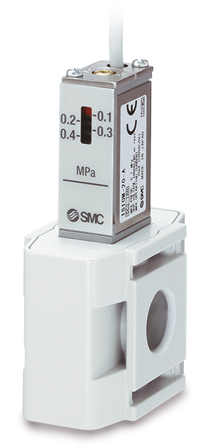
SWITCHOVER DOCUMENT
IS10 Series
Pressure Switch

Slide 2
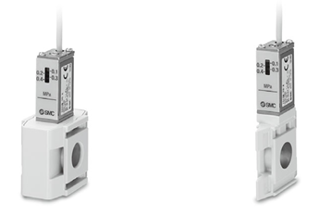

Improved features and related benefits
Feature
Clean design and uniform style
Customer Benefit
Improved appearance and reduced foreign matter accumulation
Feature
Reduced dimensions with body type variations selectable (IS10M-#):
  Standard type
  Slim type
Customer Benefit
Compact, integrated pressure switch that can be easily installed to facilitate the pressure detection of the line
IS10M-A
IS10M-D (Standard)
IS10M-D (Slim)

Slide 3

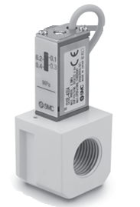
Improved features and related benefits
Feature
Reduced dimensions (IS10E-#)
Customer Benefit
Compact, integrated pressure switch that can be easily installed to facilitate the pressure detection of the line
IS10E-A
IS10E-D

Slide 4
Technical details
Standard Specification (IS10#-A/D)
Model | IS10#-A (Old) | IS10#-D (New)
Fluid | Air | Air
Ambient and fluid temperature | −5 to 60°C(with no freezing) | −5 to 60°C(with no freezing)
Proof pressure | 1.0 MPa | 1.0 MPa
Maximum operating pressure | 0.7 MPa | 0.7 MPa
Set pressure range (when OFF) | 0.1 to 0.4 MPa | 0.1 to 0.4 MPa
Hysteresis | 0.08 MPa or less | 0.08 MPa or less
Contact point configuration | 1a | 1a
Maximum contact point capacity | 2 VA (AC), 2 W (DC) | 2 VA (AC), 2 W (DC)
Operating voltage: AC, DC | 100 V or less | 100 V or less
Maximum operating current | 12 V to 24 V AC, DC: 50 mA 48 V AC, DC: 40 mA 100 V AC, DC: 20 mA | 24 VAC, DC or less: 50 mA 48 VAC, DC or less: 40 mA 100 VAC, DC or less: 20 mA
Difference in specifications

Slide 5
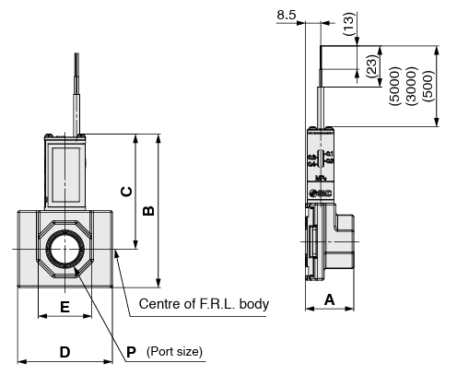
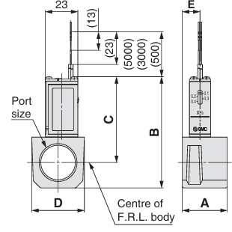
Technical details
IS10E-A (Old)
IS10E-D (New)
Dimensions
IS10E-#
 | A |  | B |  | C |  | D |  | Port size (P)
Model | Old | New | Old | New | Old | New | Old | New | Old | New
IS10M-20-# | 29.8 | 24 | 66.3 | 77.8 | 55.3 | 60.3 | 28 | 42 | 1/8 1/4 3/8 | 1/8 1/4 3/8
IS10M-30-# | 31.8 | 27 | 72.8 | 85.8 | 58.8 | 64.3 | 30 | 53 | 1/4 3/8 1/2 | 1/4 3/8 1/2
IS10M-40-# | 31.8 | 30 | 78.8 | 93.8 | 60.8 | 68.3 | 37 | 71 | 1/4 3/8 1/2 3/4 | 1/4 3/8 1/2 3/4
Difference in specifications

Slide 6
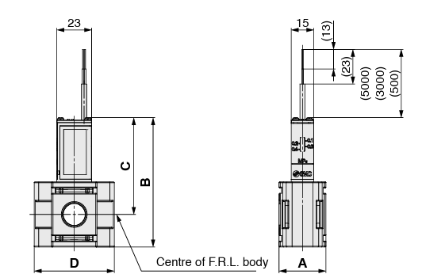
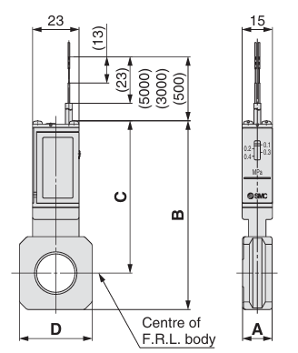
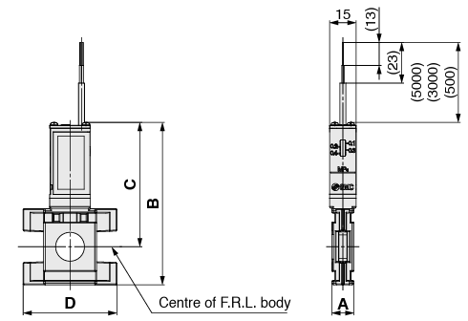
IS10M-D (New)
Technical details
Dimensions
IS10M-#
Standard
IS10M-A (Old)
Slim
 | A |  |  | B |  |  | C |  |  | D
Model | Old | New (Std) | New (Slim) | Old | New (Std) | New (Slim) | Old | New (Std) | New (Slim) | Old | New (Std) | New (Slim)
IS10M-20-# | 10.6 | 28 | 10.6 | 74.2 | 77.6 | 83.8 | 64.4 | 60.1 | 66.3 | 28 | 42 | 42
IS10M-30-# | 12.6 | 31 | 12.6 | 84.5 | 85.6 | 91.8 | 70.5 | 64.1 | 70.3 | 30 | 53 | 53
IS10M-40-# | 14.6 | 39 | 14.6 | 93.3 | 93.6 | 97.8 | 75.3 | 68.1 | 72.3 | 36 | 71 | 58.6
IS10M-50-# | 16.6 | 47 | 16.6 | 97.3 | 96.6 | 100.8 | 77.3 | 69.6 | 73.8 | 44 | 71 | 59.3
Difference in specifications

