Slide 1
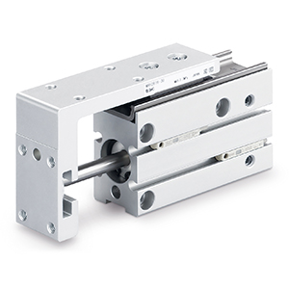
SWITCHOVER DOCUMENT
MXH2 Series
Compact Slide

Slide 2
Improved features and related benefits
Feature:
High-precision linear guide:
  Displacement due to a force acting in the pitch direction: up to 48 % reduction
  Displacement due to a force acting in the yaw direction: up to 63 % reduction
  Displacement due to a force acting in the roll direction: up to 90 % reduction
Customer Benefit:
Boost your machine performance
Feature:
Stroke up to 150 mm
Customer Benefit:
Reach long distances
Feature:
Weight as low as 61 g for the smallest size
Customer Benefit:
Get lightweight machines

Slide 3
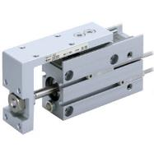
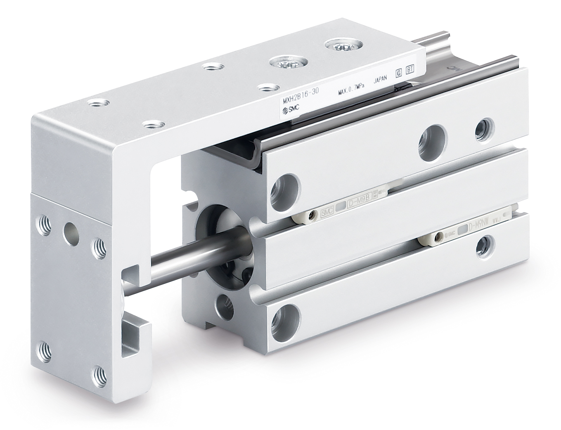
Technical details
Standard specifications
Series | Current MXH-Z | New MXH2
Picture
Bore sizes [mm] | Ø 6, Ø 10, Ø 16, Ø 20 | Ø 6, Ø 10, Ø 16, Ø 20, Ø 25
Minimum operating pressure [MPa] | 0.05 | 0.08
Maximum operating pressure [MPa] | 0.7 | 0.7
Minimum ambient temperature [ºC] | −10 | −10
Maximum ambient temperature [ºC] | Without autoswitch: 70 With autoswitch: 60 | Without autoswitch: 70 With autoswitch: 60
Cushion | Rubber bumper on both ends | Rubber bumper on both ends
Standard strokes [mm] | 5, 10, 15, 20, 25, 30, 40, 50, 60 | 5, 10, 15, 20, 25, 30, 40, 50, 60, 75, 100, 125, 150
Difference in specifications

Slide 4
Technical details
Dimensions
General dimensions
The product outer dimensions, workpiece mounting dimensions,
and cylinder mounting are interchangeable with each other

