Slide 1
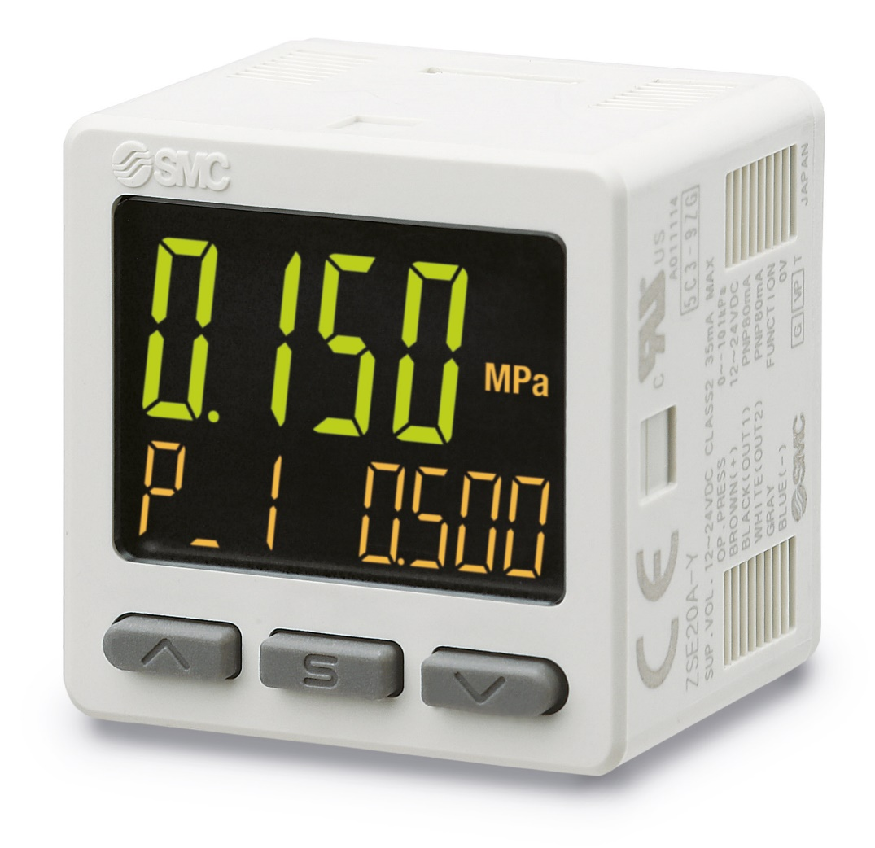
SWITCHOVER DOCUMENT PSE300A Series 3-Screen Display Sensor Monitor

Slide 2
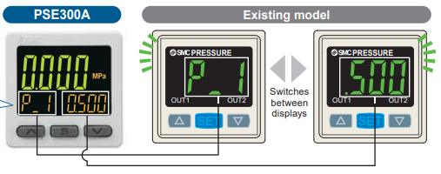
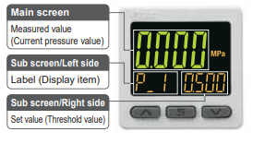
Improved features and related benefits
Feature
Visualisation of settings
3-Screen display. It can display simultaneously the current flow rate and another selectable value.
Customer Benefit
Item and set value are displayed together, making it easy to confirm the displayed item
More information at a glance.
Feature
Possibility of changing the settings while checking the measured value.
Customer Benefit
Flexible configuration.
Switches between displays
Main screen
Measured value (Current pressure value)
Sub screen/Left side
Label
Sub screen/Right side
Set value (Threshold value)
The sub screen can be switched by pressing the up/down buttons.
OUT1 Set value (Threshold value)
OUT1 Set value (Hysteresis value)
OUT2 Set value (Threshold value)
OUT2 Set value (Hysteresis value)
Bottom value
Peak value

Slide 3
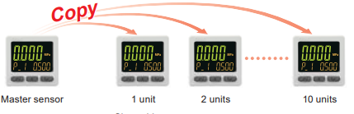
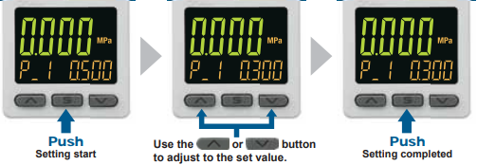
Improved features and related benefits
Feature
Copy function. The settings of the master sensor can be copied to the slave sensors.
Customer Benefit
Quick & easy installation.
Master sensor
1 unit
2 units
10 units
Feature
Simple 3-Step setting.
Customer Benefit
User friendly, easy & quick setting.
Push
Setting start
Adjust the set value
Push
Setting completed
Feature/
NPN/PNP switch function.
Customer Benefit
Reduction of the number of stocked items and references.

Slide 4
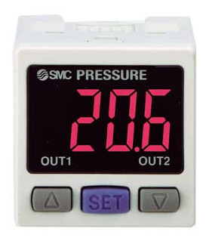
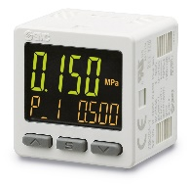
Difference in specifications
Standard Specification
Technical details
Series | Current PSE300 | New PSE300A
Picture
Power supply voltage | 12 to 24 VDC ± 10 %, with 10 % ripple (p-p) or less
Current consumption | 50 mA or less (Current consumption for sensor is not included.) | 35 mA or less
Display accuracy | ±0.5 % F.S. ±1 digit | ±0.5 % F.S. ±2 digits (± 100 kPa) ±0.5 % F.S. ±1 digit
Repeatability | ± 0.1 % F.S. ± 1 digit
Temperature characteristics | ± 0.5 % F.S. (Reference: 25 ℃)
Output Specifications | NPN or PNP open collector output: 2 outputs (switching type) | NPN or PNP open collector output: 2 outputs (selected by model number)
Hysteresis | Variable from 0
Input type | PSE30: Voltage input 1 to 5 VDC (Input impedance: 1 MΩ) PSE31: Current input 4 to 20 mA DC (Input impedance: 100 Ω) | PSE30A: Voltage input 1 to 5 VDC (Input impedance: 1 MΩ) PSE31A: Current input 4 to 20 mA DC (Input impedance: 51 Ω)
Display | 3 + 1/2 digit, 7 segment indicator, 2-colour display (Red/Green), Sampling frequency: 5 times/sec | 3-screen display (Main screen, Sub screen x 2), Main screen: Red/Green, Sub screen: Orange
Display unit | MPa, kPa, Pa, kgf, bar, mmH2O, mmHg, inHg, psi, mbar | MPa, kPa
Enclosure | IP40
Operating temperature range | Operating: 0 to 50 ℃, Stored: -10 to 60 ℃ (No condensation)
Weight (Body) | 30 g (Excludes power supply and output cable) | 25 g (Excludes power supply and output cable)

Slide 5
Technical details
Dimensions
General dimensions
Old PSE300
A
B
D
F
Depth: 4
Power supply/Output connector
C
Sensor connector
E
New PSE300A
A
Sensor connector
C
B
D
F
E
Depth: 7 or less
F
Power supply/Output connector
A |  | B |  | C |  | D |  | E |  | F
Current | New | Current | New | Current | New | Current | New | Current | New | Current | New
20 | 20 | 31 | 25 | 1.5 | 1.5 | 3 | 2.7 | 8.2 | 7.7 | 30 | 30

Slide 6
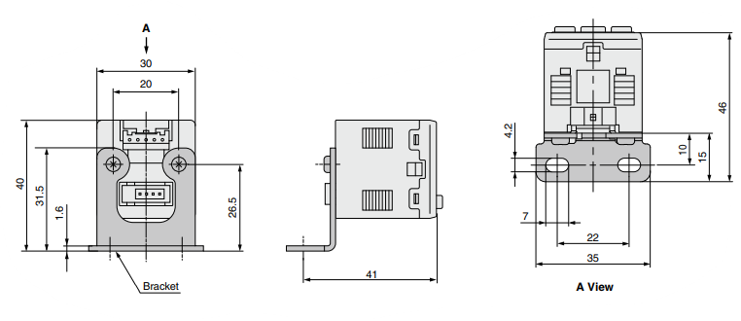
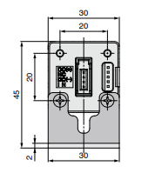
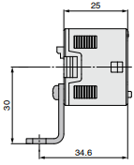
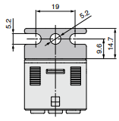
Technical details
Dimensions
Bracket
Old PSE300
E
G
H
I
A
B
C
D
New PSE300A
E
B
G
H
I
A
C
B
F
D
A |  | B |  | C |  | D |  | E |  | G |  | H |  | I
Current | New | Current | New | Current | New | Current | New | Current | New | Current | New | Current | New | Current | New
40 | 45 | 1.6 | 2 | 25 | 30 | 41 | 34.6 | 31 | 25 | 4.2 | 5.2 | 10 | 9.6 | 15 | 14.7

Slide 7
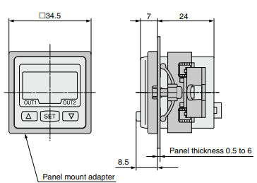
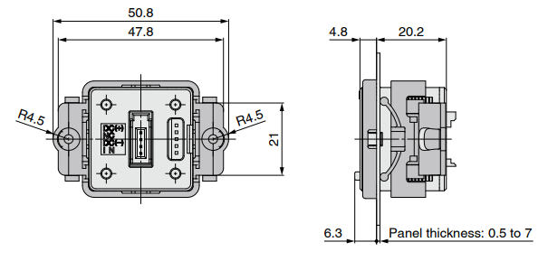
Technical details
Dimensions
Panel mount adapter
Old PSE300
A
B
C
D
New PSE300A
A
B
C
D
A |  | B |  | C |  | D
Current | New | Current | New | Current | New | Current | New
7 | 4.8 | 24 | 20.2 | 8.5 | 6.3 | Panel thickness 0.5 to 6 | Panel thickness 0.5 to 7

Slide 8
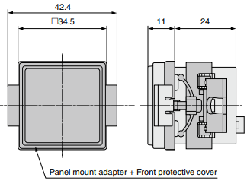
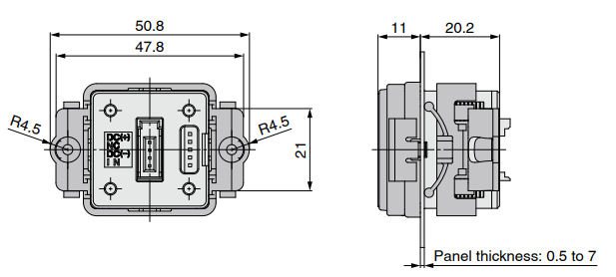
Technical details
Dimensions
Panel mount adapter + Front protection cover
Old PSE300
A
B
C
New PSE300A
A
B
C
A |  | B |  | C
Current | New | Current | New | Current | New
10.8 | 11 | 24 | 20.2 | Panel thickness 0.5 to 6 | Panel thickness 0.5 to 7

